Slide 1
CSE13S-02 Friday Section- 01/14/2022
TA-Nayan Sanjay Bhatia
Email: nbhatia3@ucsc.edu

Slide 2
Bash commands
Listing files in directory
ls
Print them with extra metadata:
ls -l
Print hidden files and folders (begin with a .)
ls -a
Moving/renaming files and folders
mv from_file to_file
Changing directories
cd directory_name
cd ..
Viewing current directory
pwd
Creating a directory
mkdir directory_name
Removing a file
rm file_name
Removing a directory
rm -r directory_name

Slide 3
apt
If you need something installed e.g. vim, you want to use a package manager on linux distros
We will be using the apt package manager
Installing packages
sudo apt install package_name

Slide 4
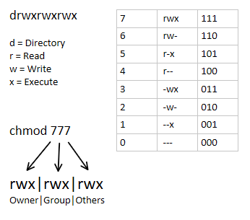
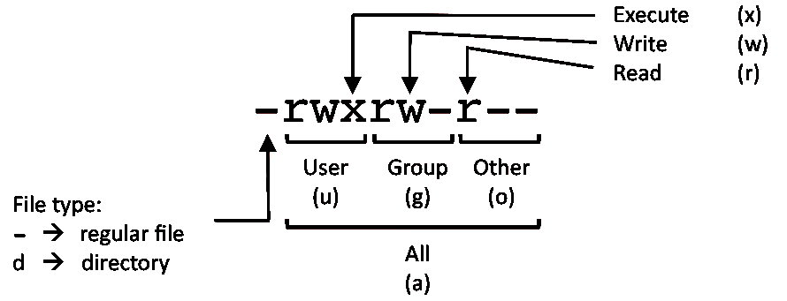
Chmod
Source: https://www.reddit.com/r/linux/comments/ayditr/chmod_cheatsheet/

Slide 5
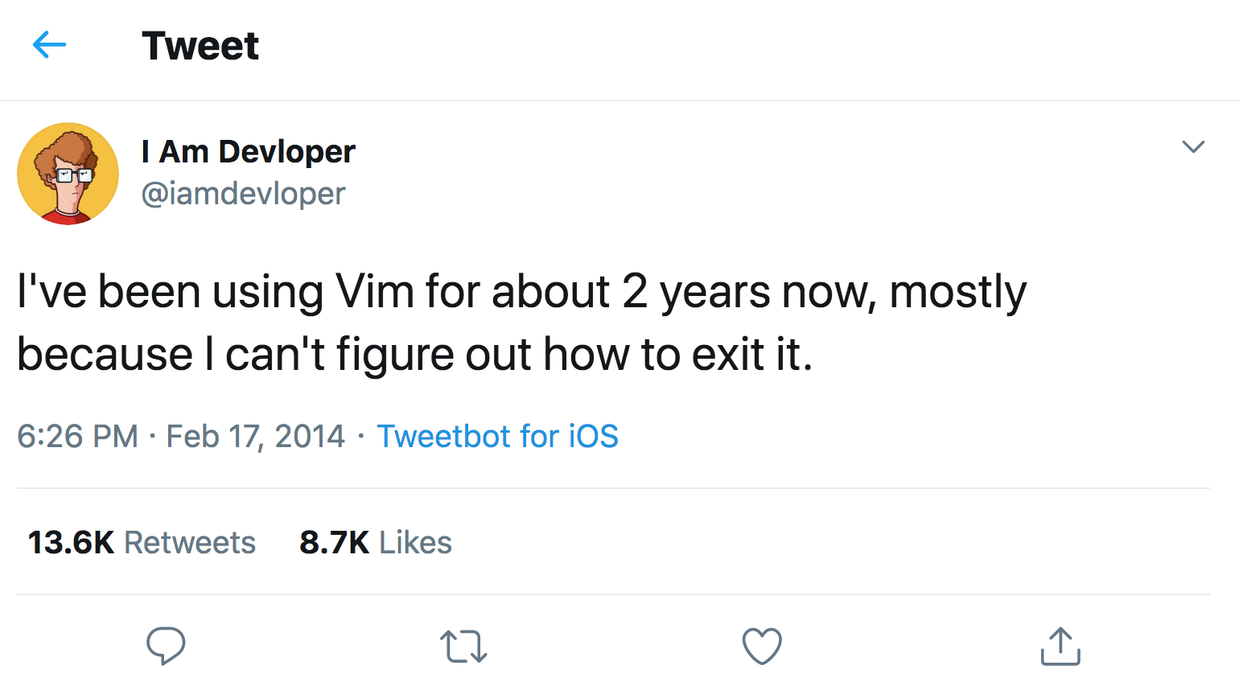
Vim
A very powerful keyboard based text editor
Opening/creating a file
vim name_of_file

Slide 6
Vim
Entering insert mode:
i
Exiting insert mode:
Esc
Save and exit (In command mode):
:wq
Exit and don't save (In command mode):
:q!
Beginners guide: https://www.linux.com/training-tutorials/vim-101-beginners-guide-vim/
Cheatsheet: https://devhints.io/vim

Slide 7
Compiler
Your computer cannot execute C code you need to compile it to a binary that your computer understands
This is the role of the compiler
We will be using the clang compiler
Basic usage:
clang file_name1 file_name2 …
For more advanced usage, we want to use flags

Slide 8
Compiler flags
Name the compiled binary
clang input.c -o output_binary_name
Lots of others - see the homework

Slide 9
The man command
If you ever forget what a command does, or what it takes as parameters, use the man command - manual
Usage:
man command_name

Slide 10
Final notes
Both your shell environment and vim are extremely configurable - if you find that you are having to do something repeatedly or something is tedious, there probably is an easy way to fix it
Google around to see how you can configure both your shell environment and .vimrc to make your life easier!

